Slide 1
Cute Animals
Generated with Michael Tr.'s Python Script

Slide 2
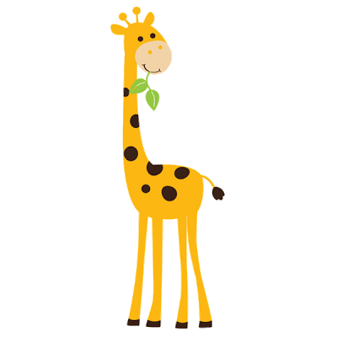
giraffe

Slide 3
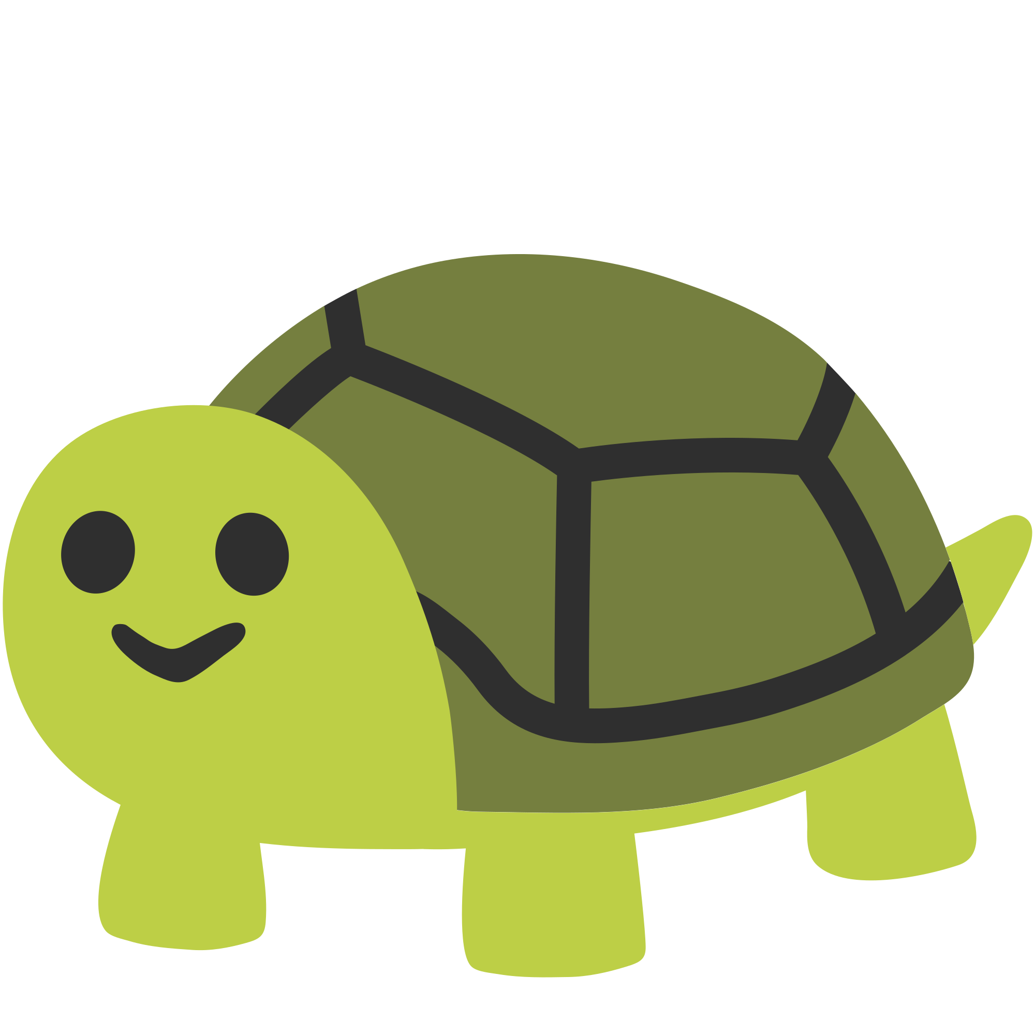
turtle

Slide 4
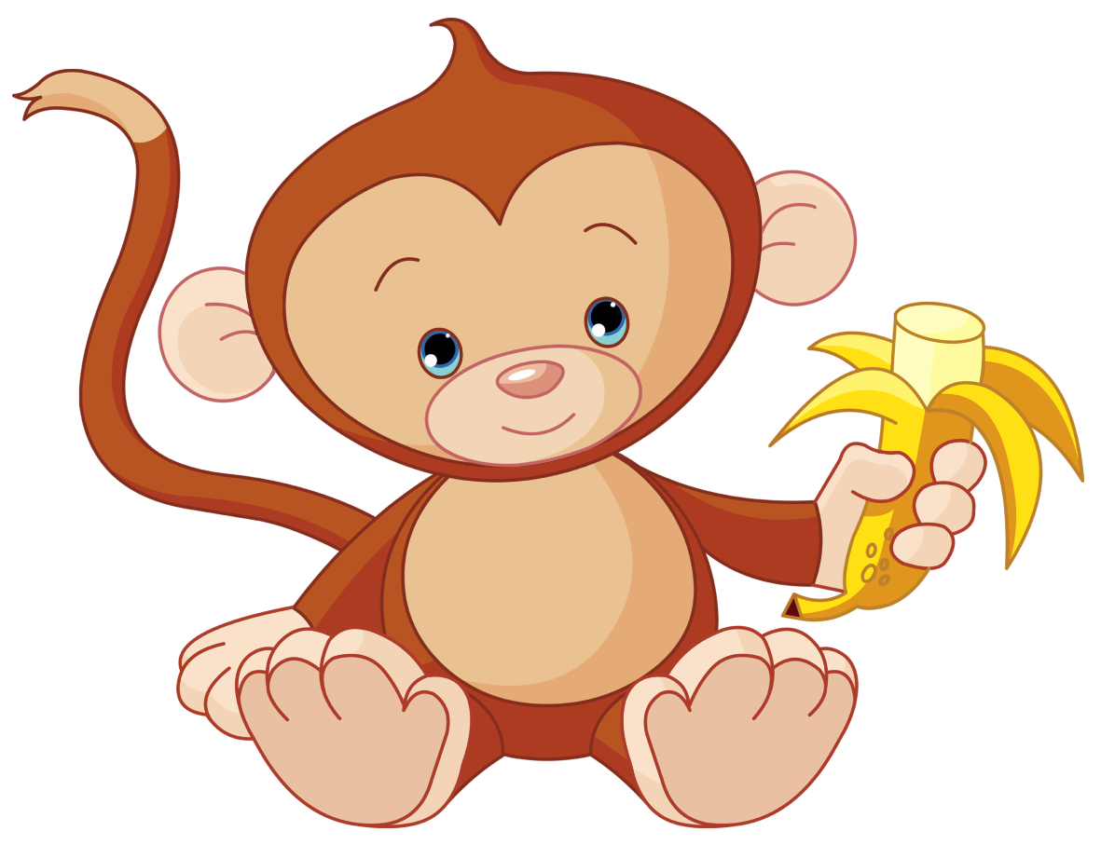
monkey

Slide 5
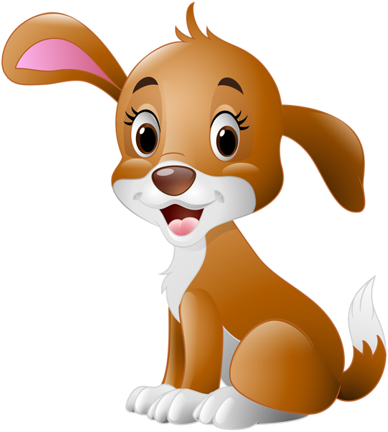
dog

Slide 6
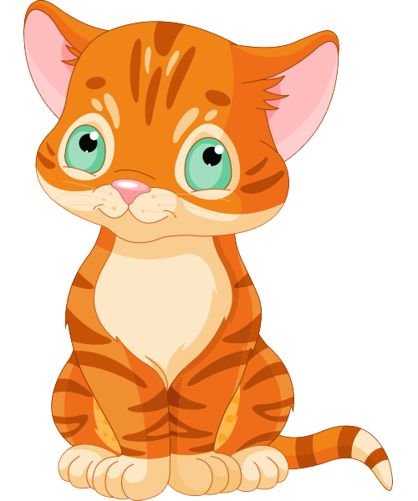
cat

Slide 7
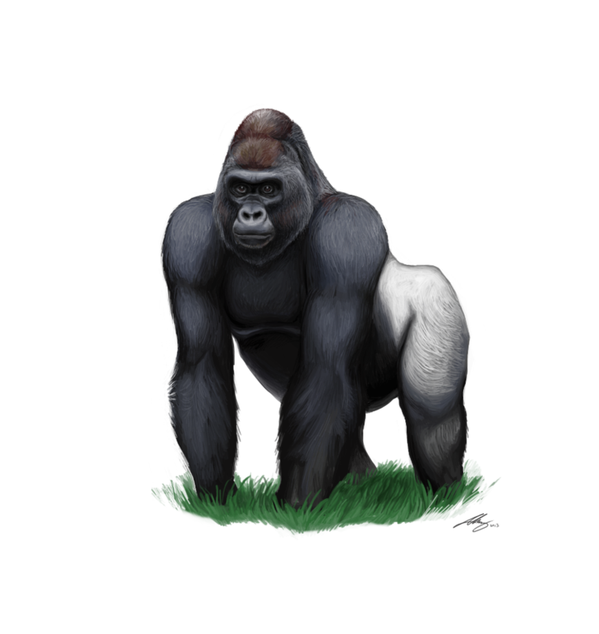
gorilla

